Slide 1






LIBRARY MANAGEMENT SYSTEM
Submitted by : Mehak negi
Sap Id : 590026050
Sumitted To : Mr Prashant trivedi

Slide 2



A library needs a system that can store and manage all its books and user information in an easy and organized way. Doing everything manually—like keeping records of books, checking availability, or finding user details—takes a lot of time and may lead to mistakes.
This project, Library Management System, is designed to make these tasks simple and fast. It helps librarians and users manage books, borrow or return them, and view important information without confusion. The system reduces paperwork and makes the whole library process smoother and more efficient.”

Slide 3
Problem
Managing library operations manually—such as storing book details, tracking issued books, maintaining user/admin records, and managing comments or feedback—is time-consuming and prone to errors. Traditional paper-based systems often lead to misplaced data, difficulty locating books, and inefficiency in managing user accounts.
Motivation
Libraries require fast and reliable systems to store and retrieve information. This project aims to replace manual operations with an automated system that:
Reduces human effort
Saves time
Ensures accurate record-keeping
Improves accessibility for both admin and users

Slide 4
• Why the Problem Is Important
Helps administrators manage large amounts of data efficiently
Reduces errors in recording book availability
Supports faster access to book information
Enhances user satisfaction by simplifying login, book search, and borrowing
Maintains clear data of comments, user profiles, and admin actions

Slide 5

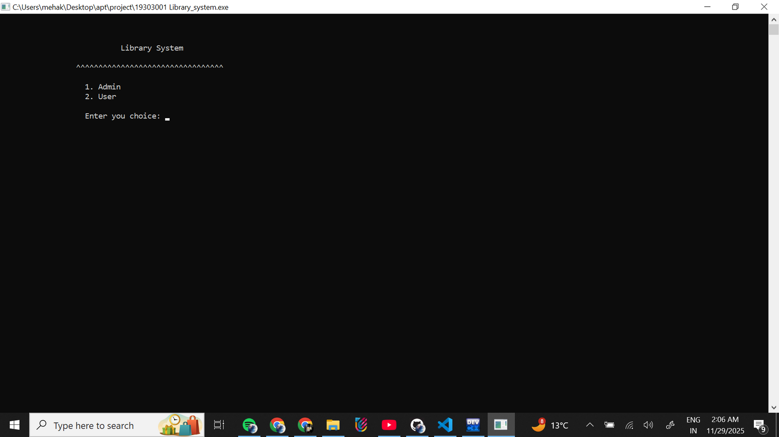

MAIN PROFILE

Slide 6

ADMIN

Slide 7

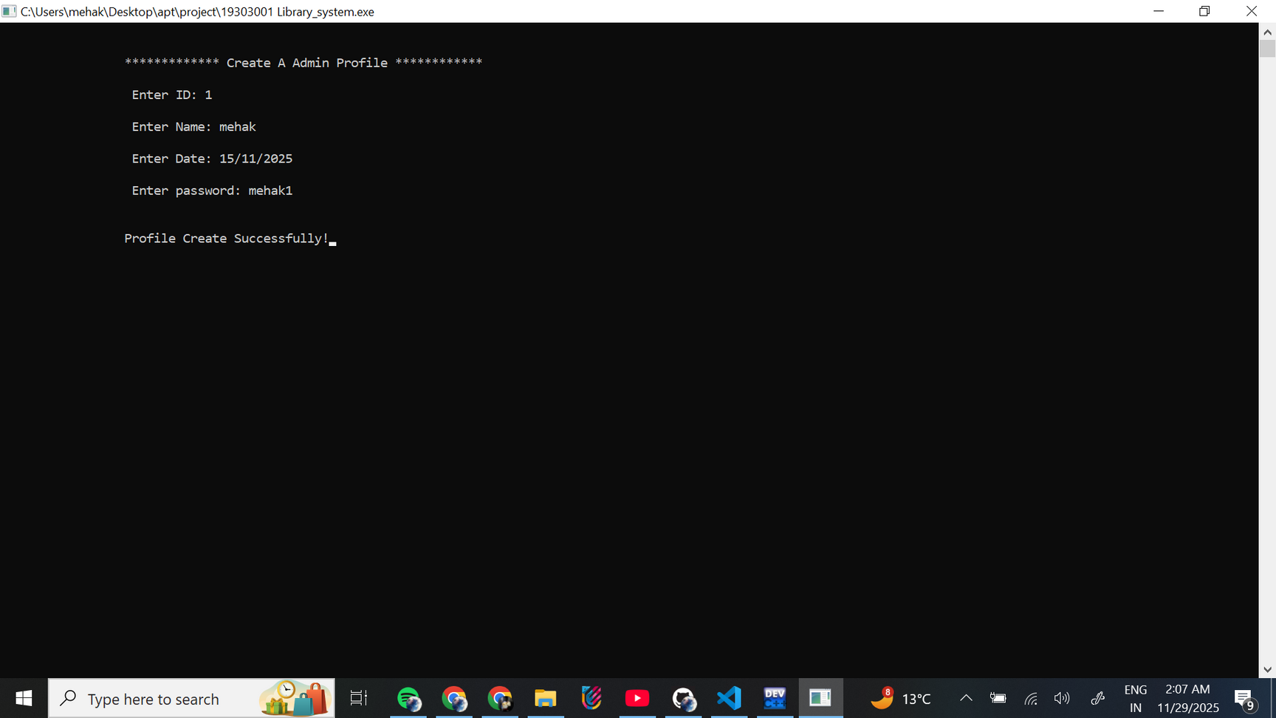

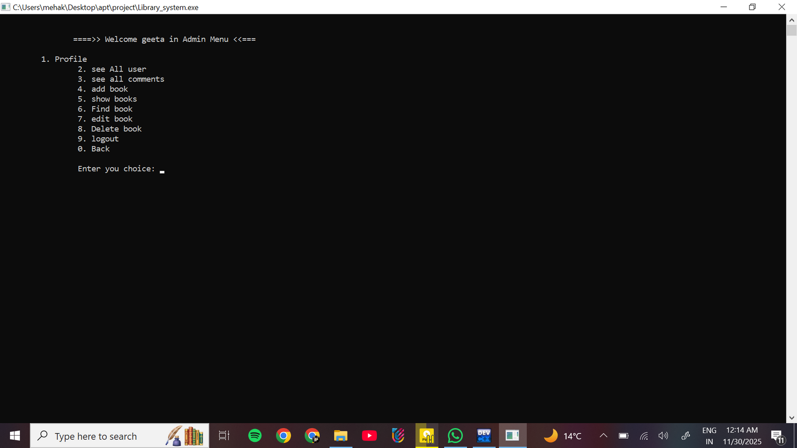
ADMIN OPTION
CREATE A ADMIN PROFILE
LOGIN
ADMIN MENU OPTION

Slide 8
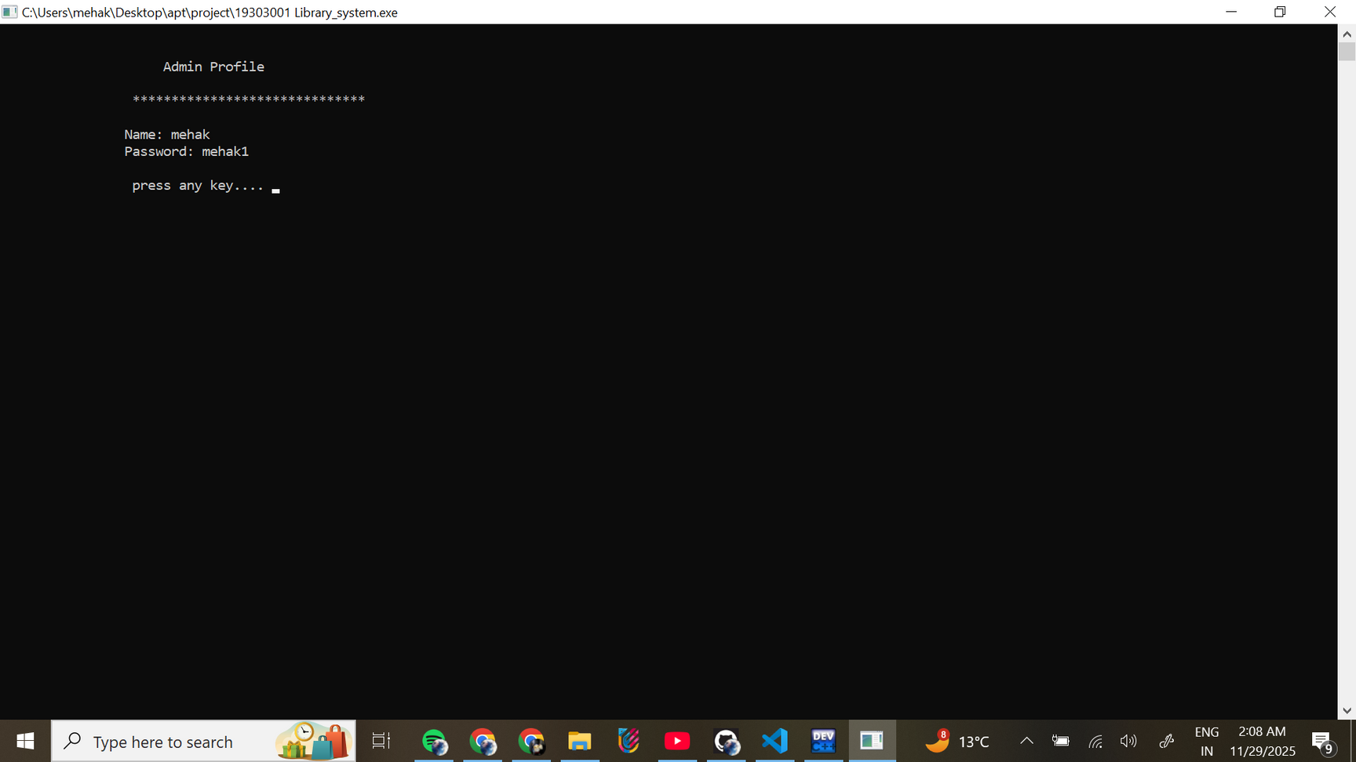
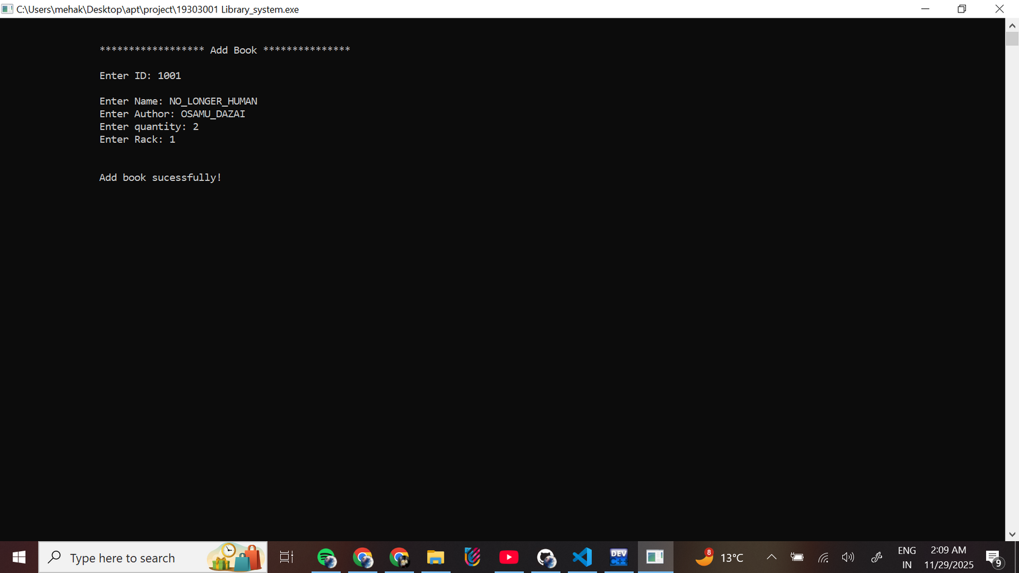
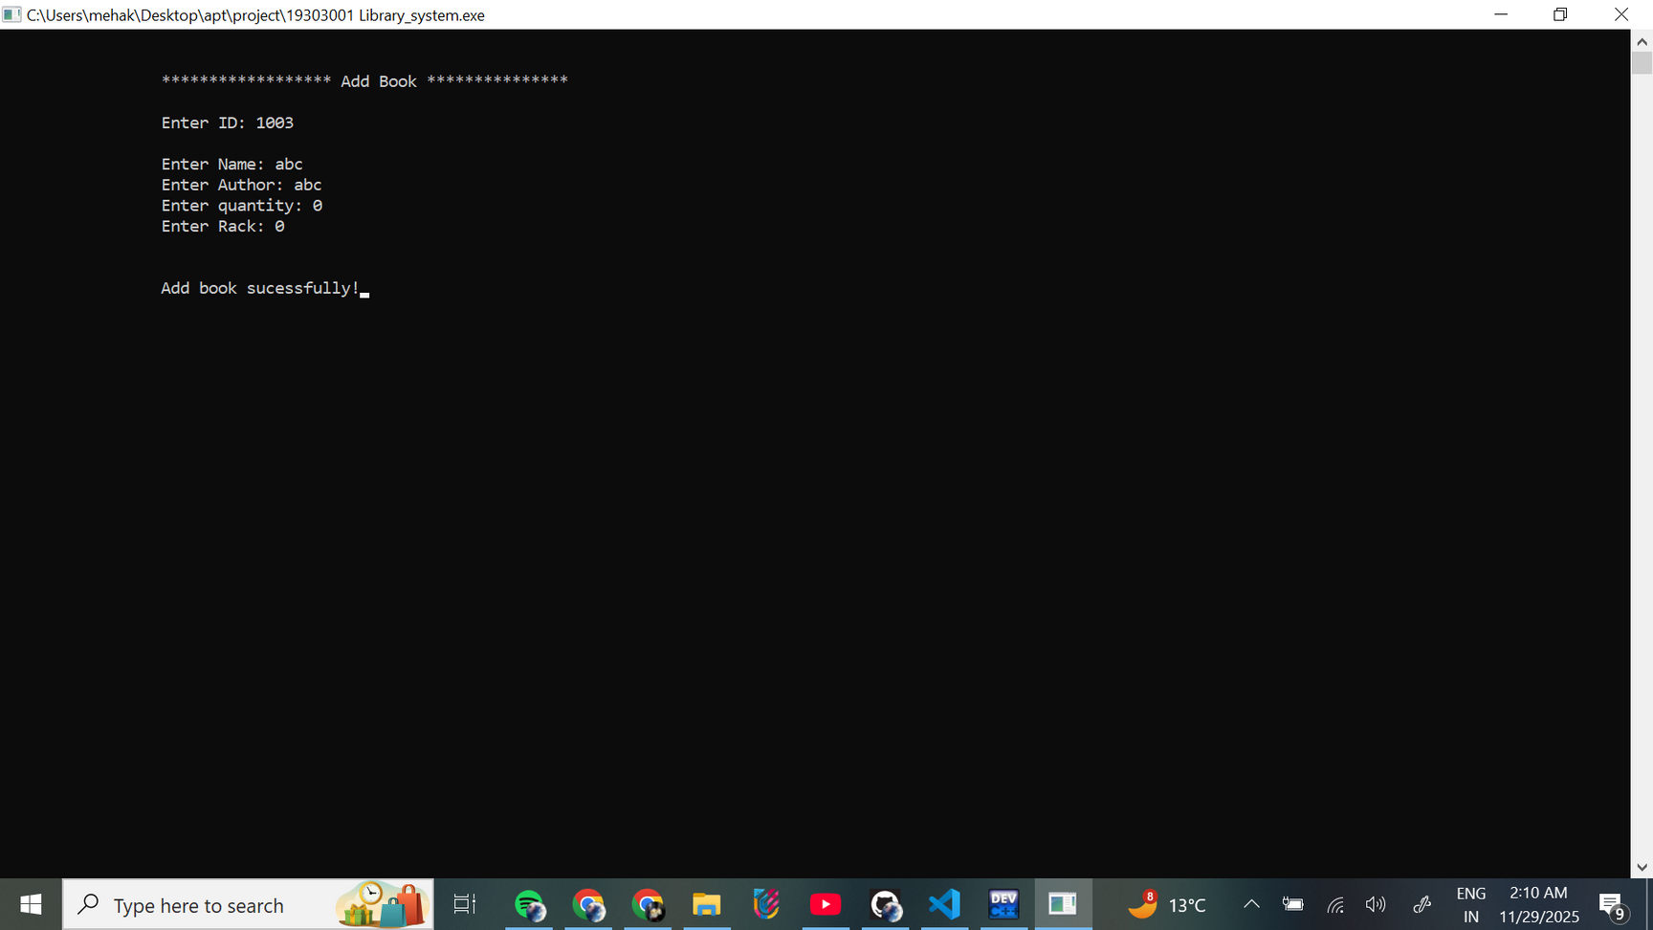
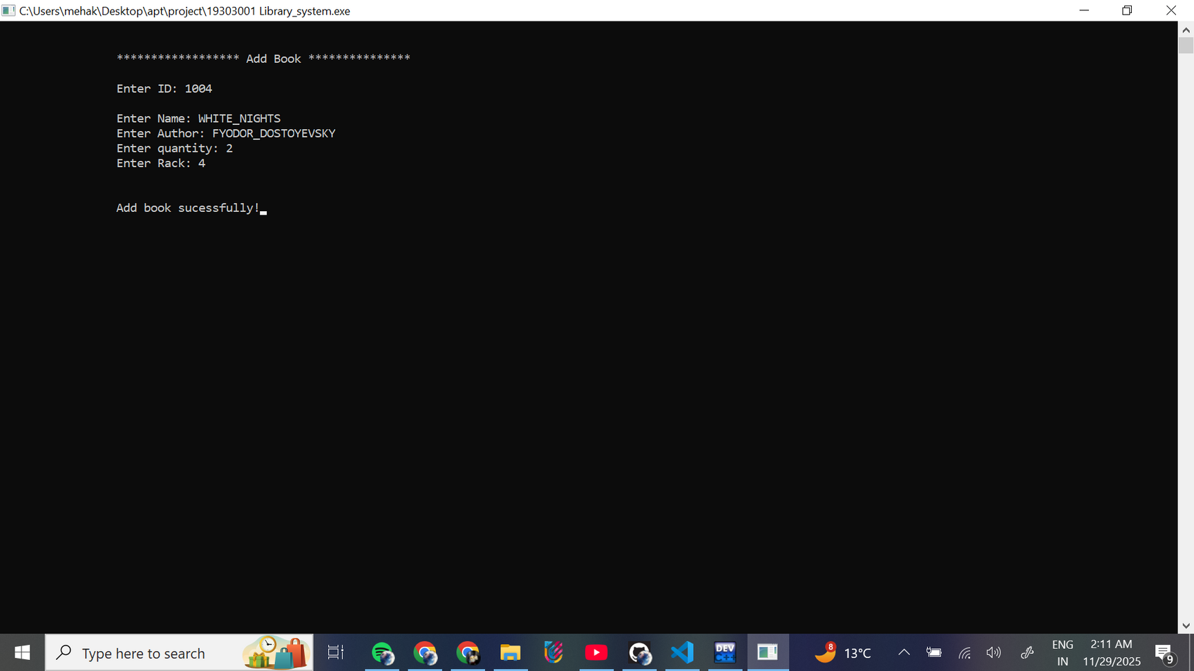
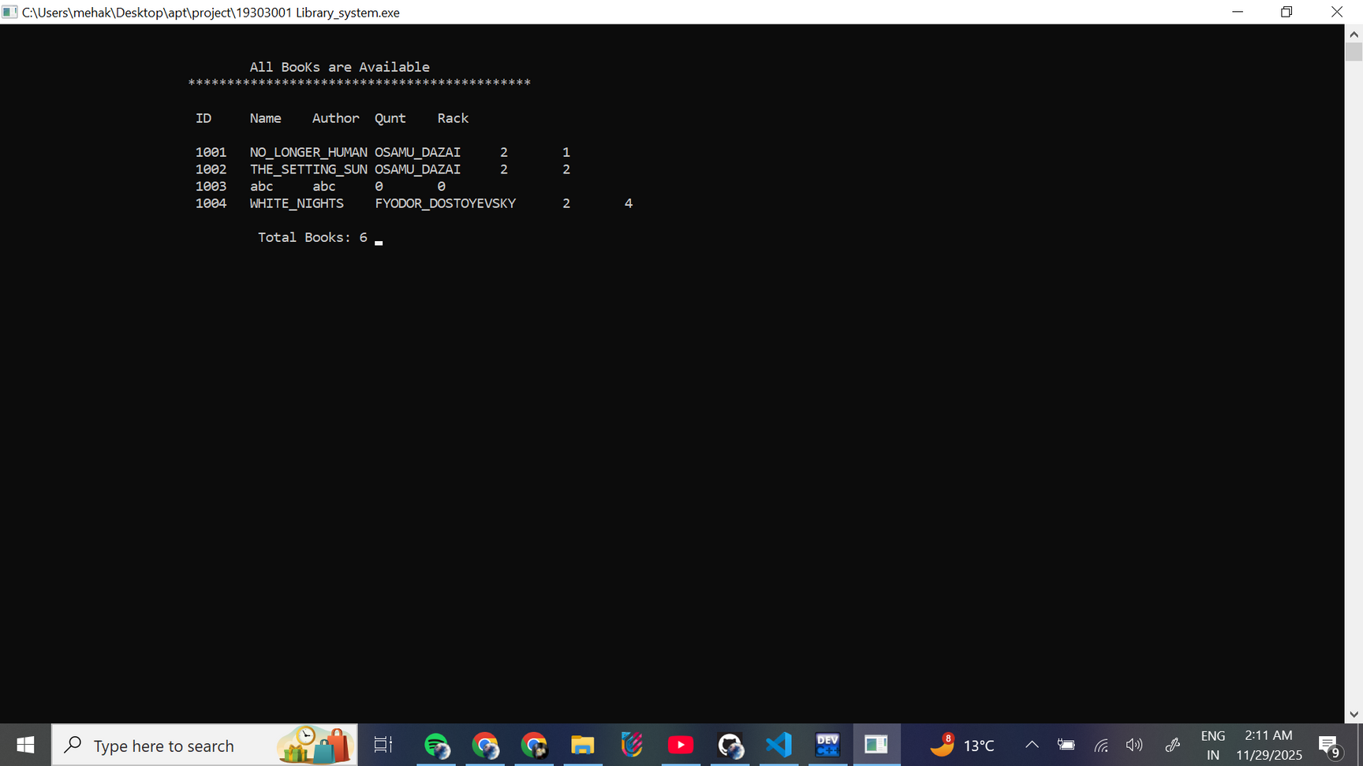
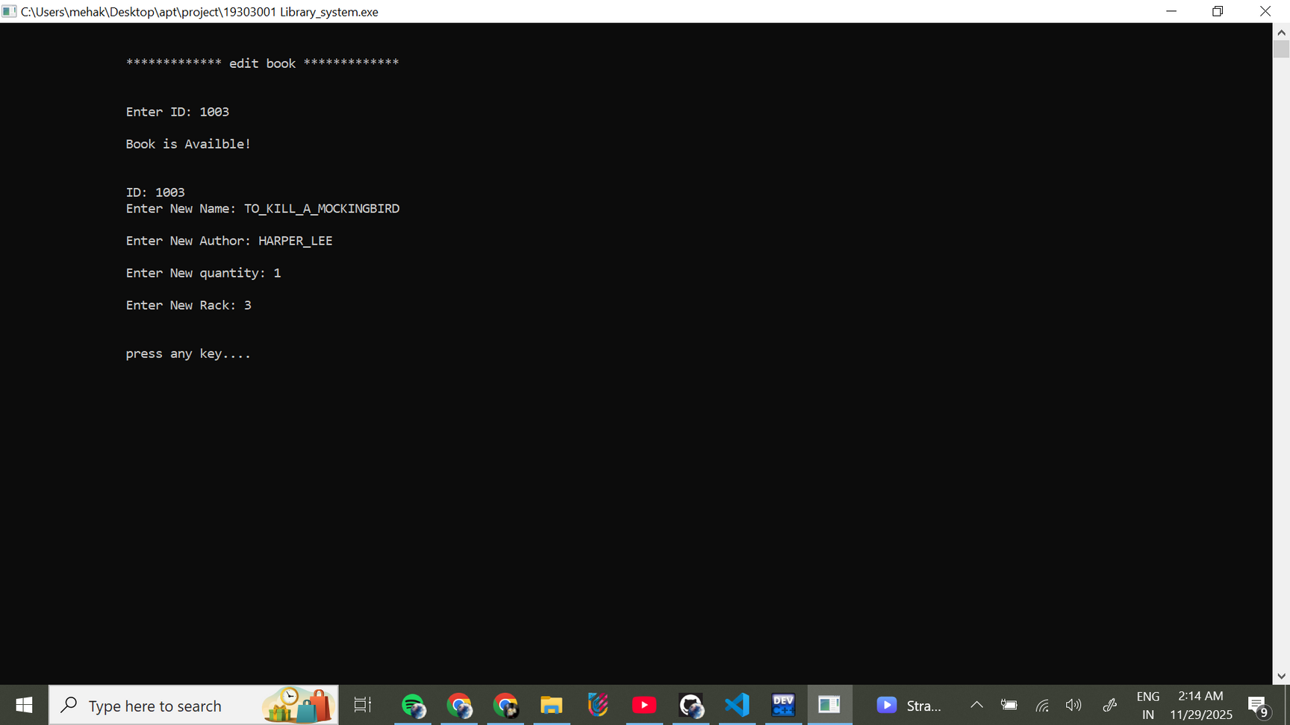
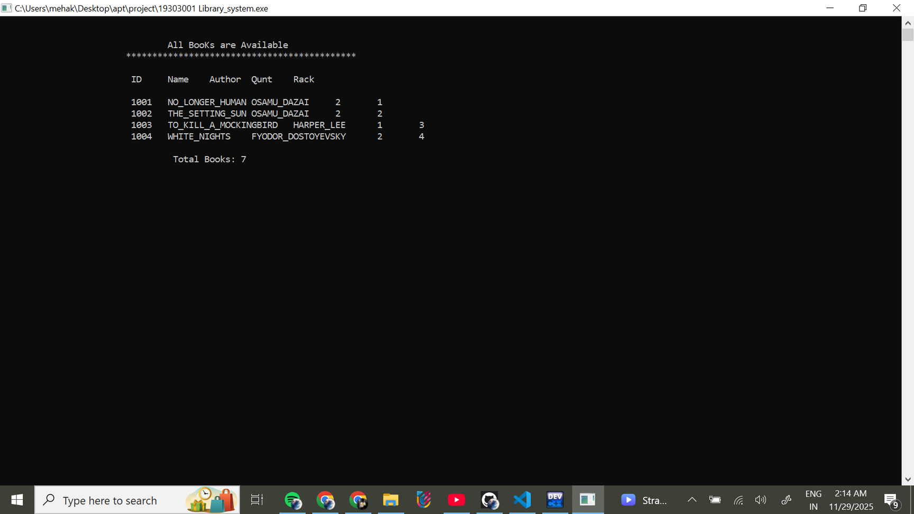
CHOICE 1
CHOICE 4
CHOICE 5
CHOICE 7

Slide 9
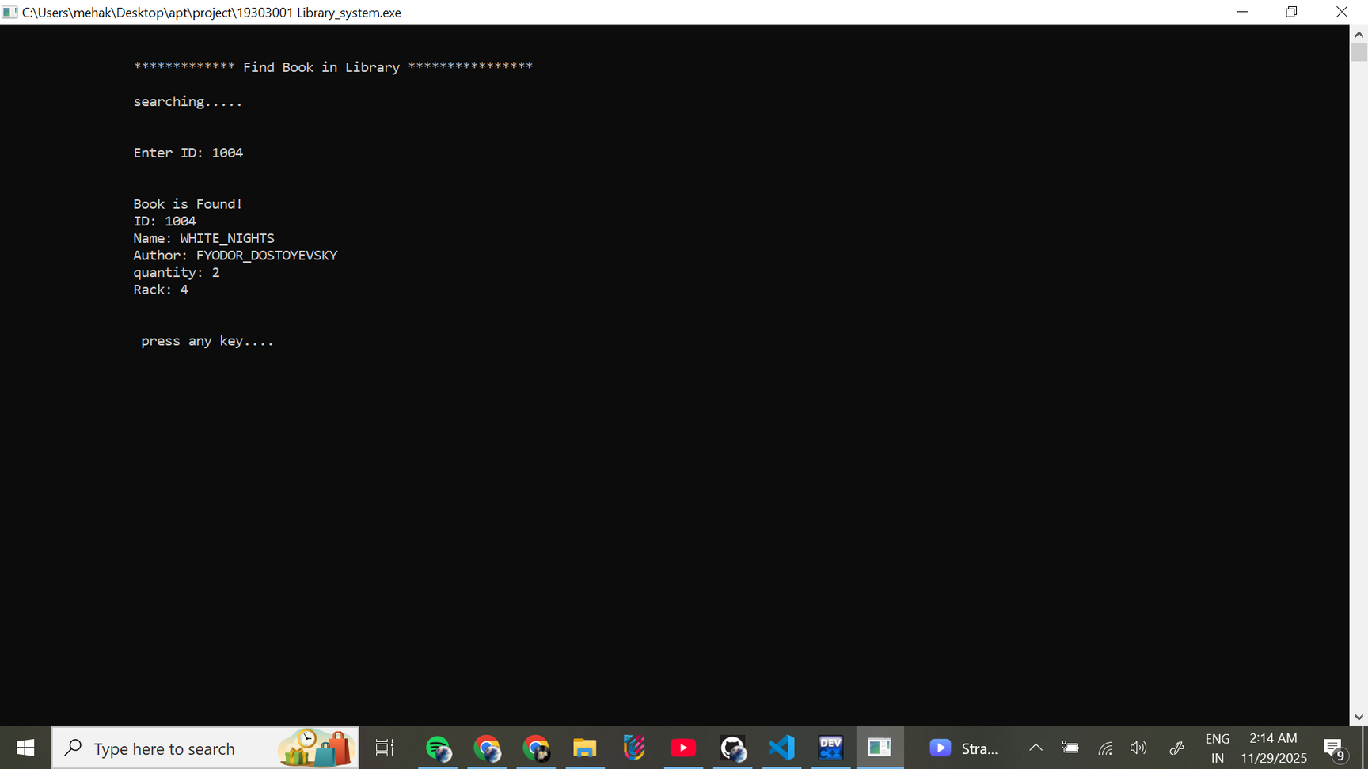
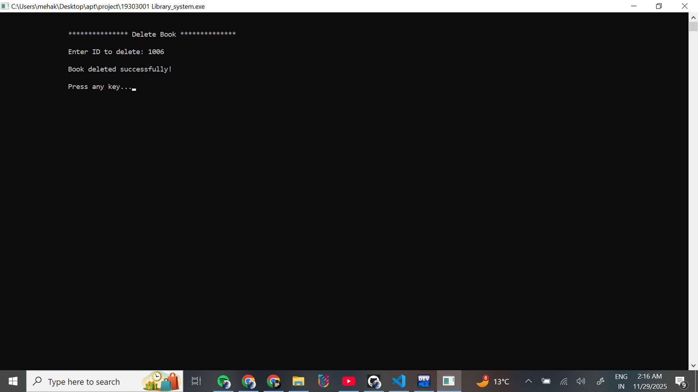
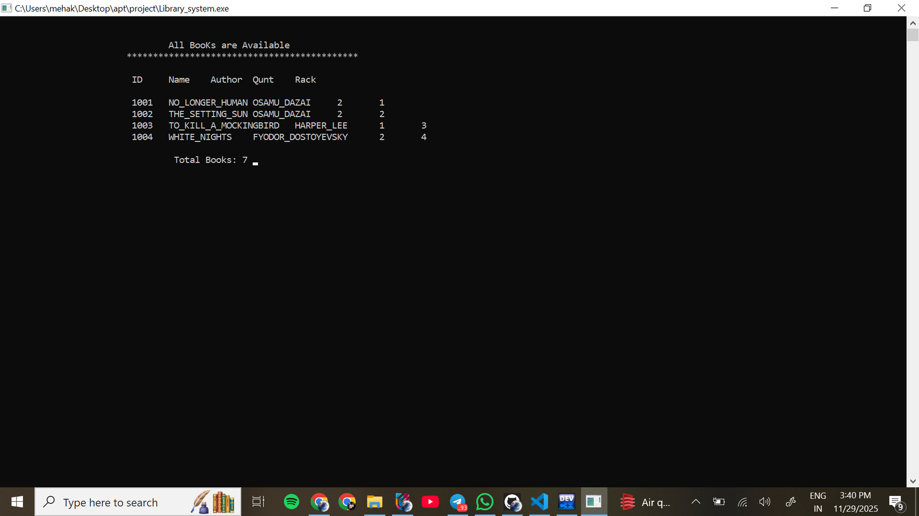
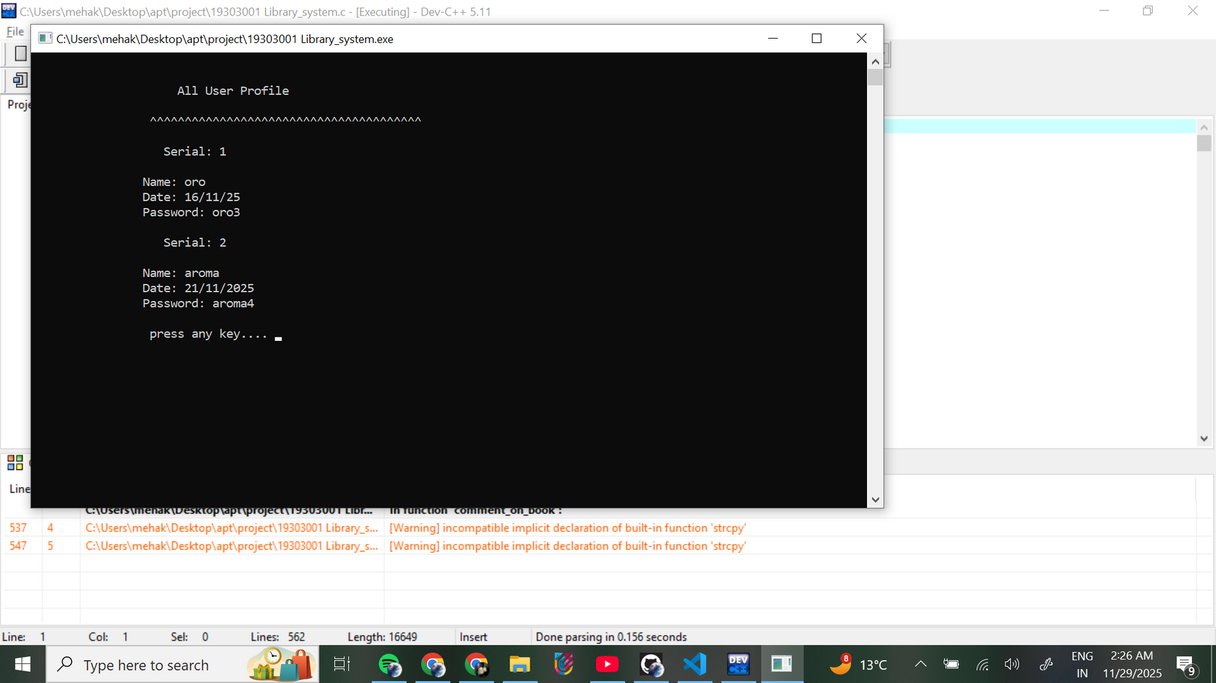
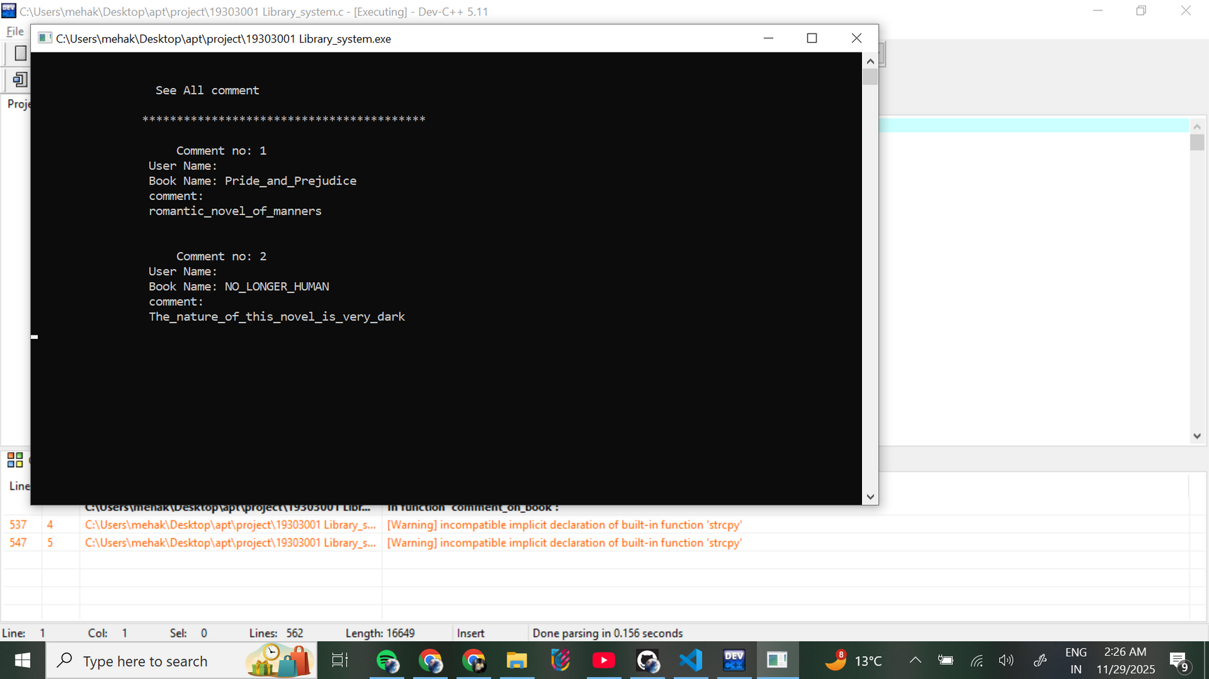
CHOICE 8
CHOICE 1
CHOICE 2

Slide 10
USER

Slide 11
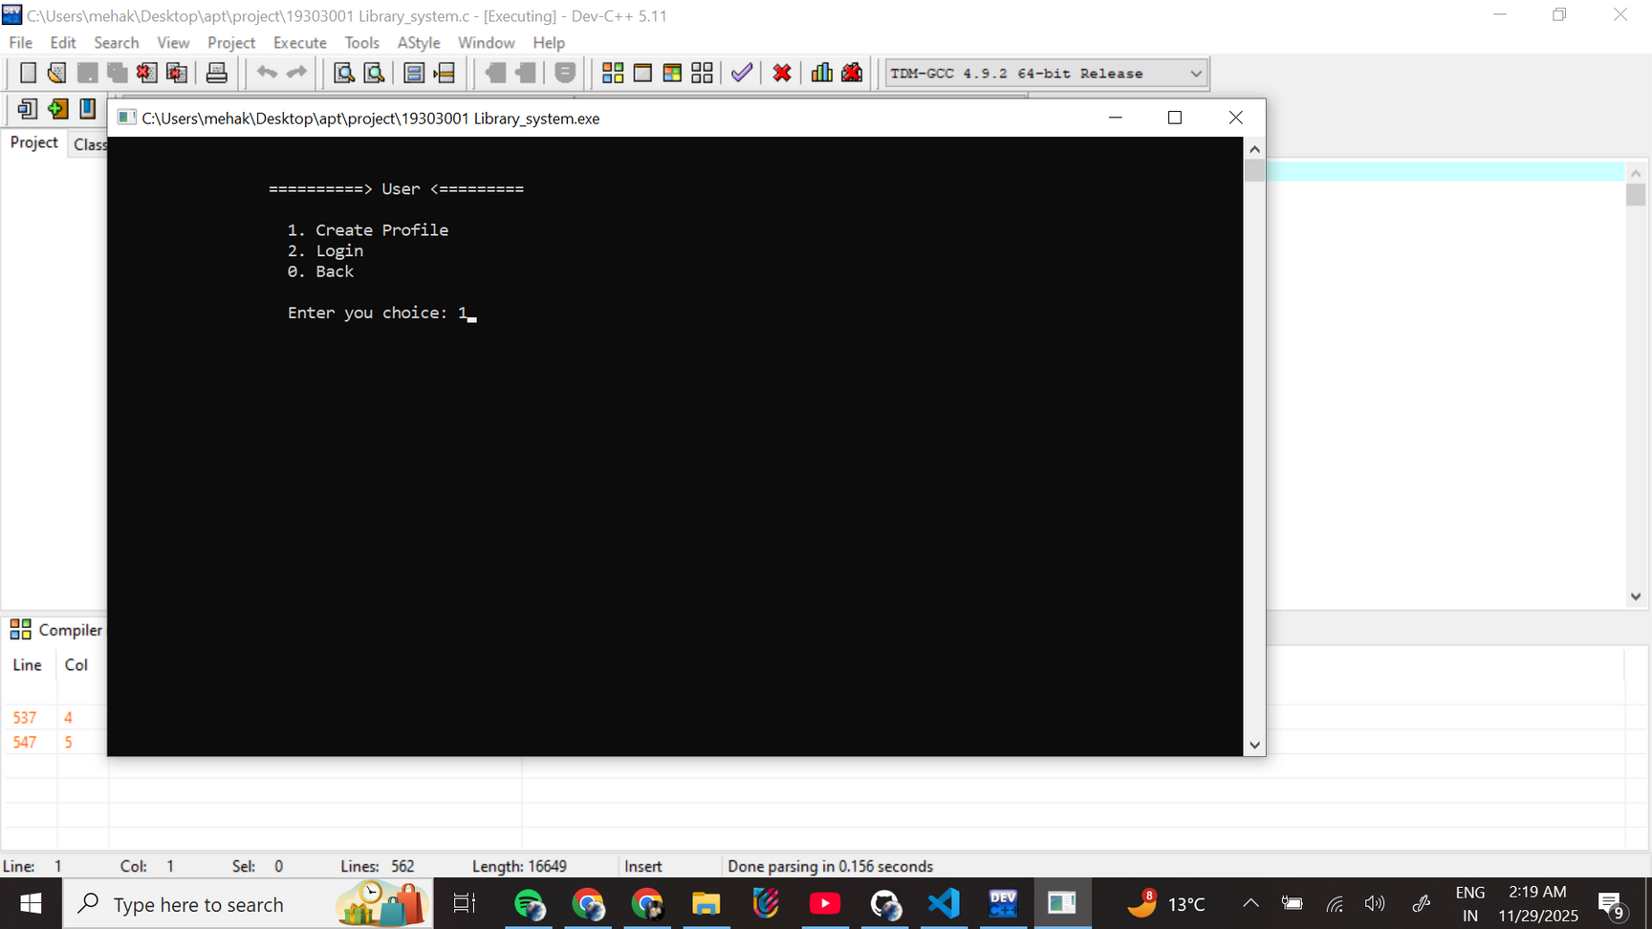
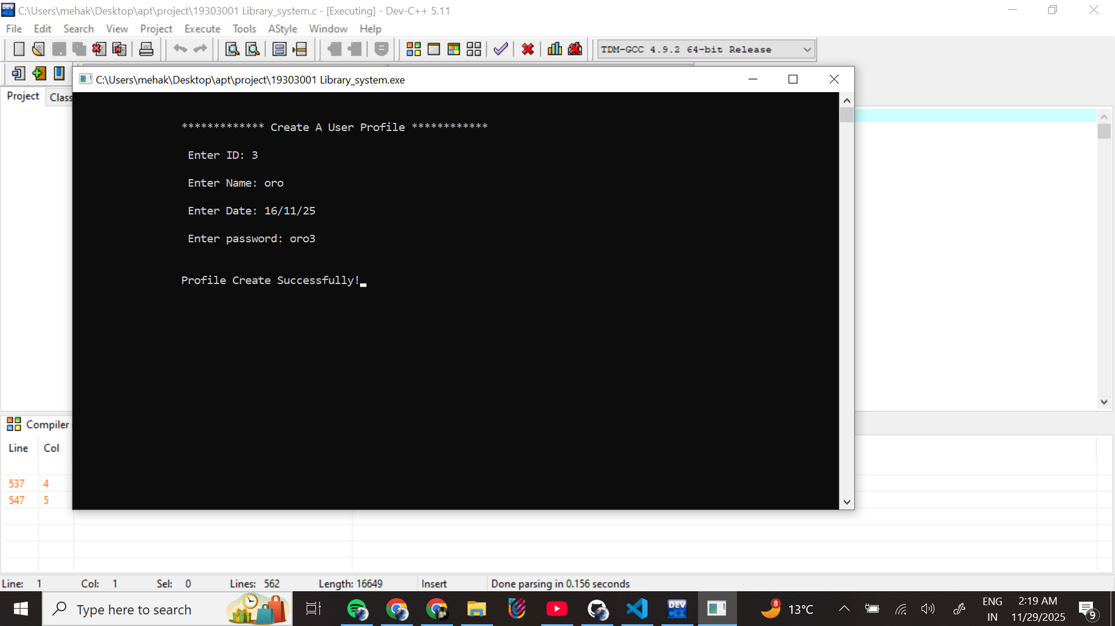
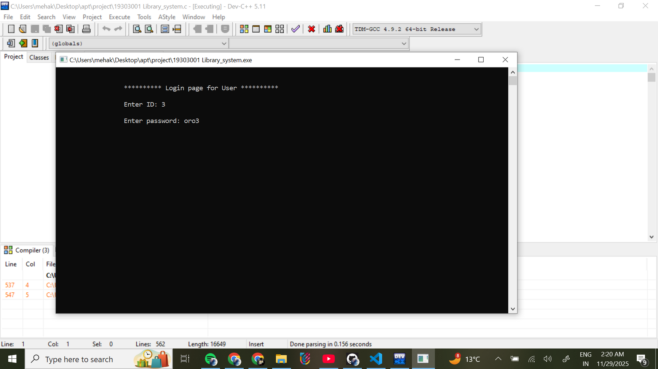
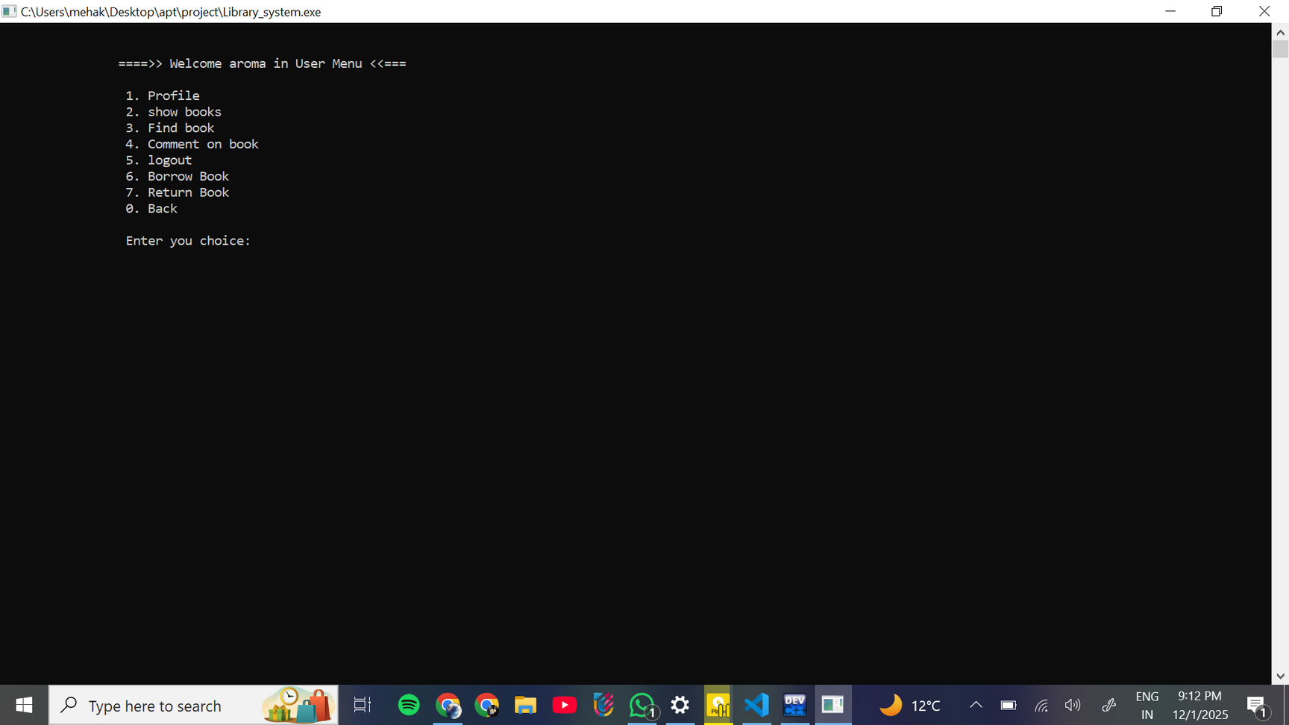
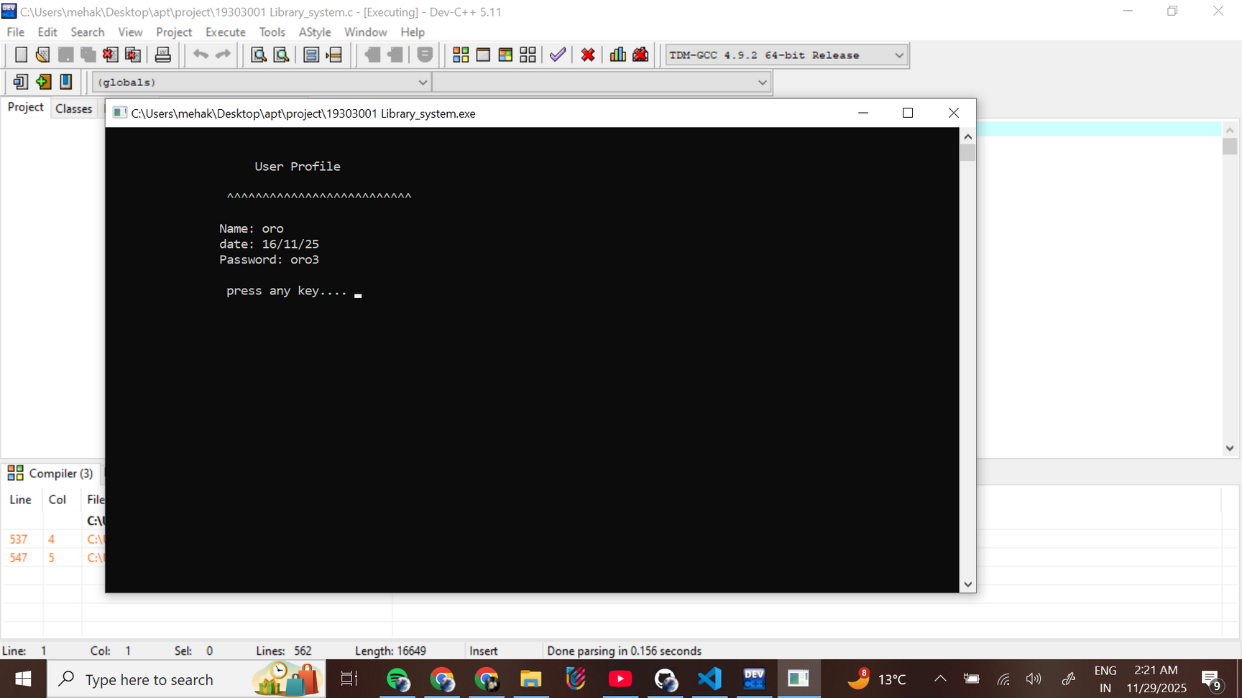
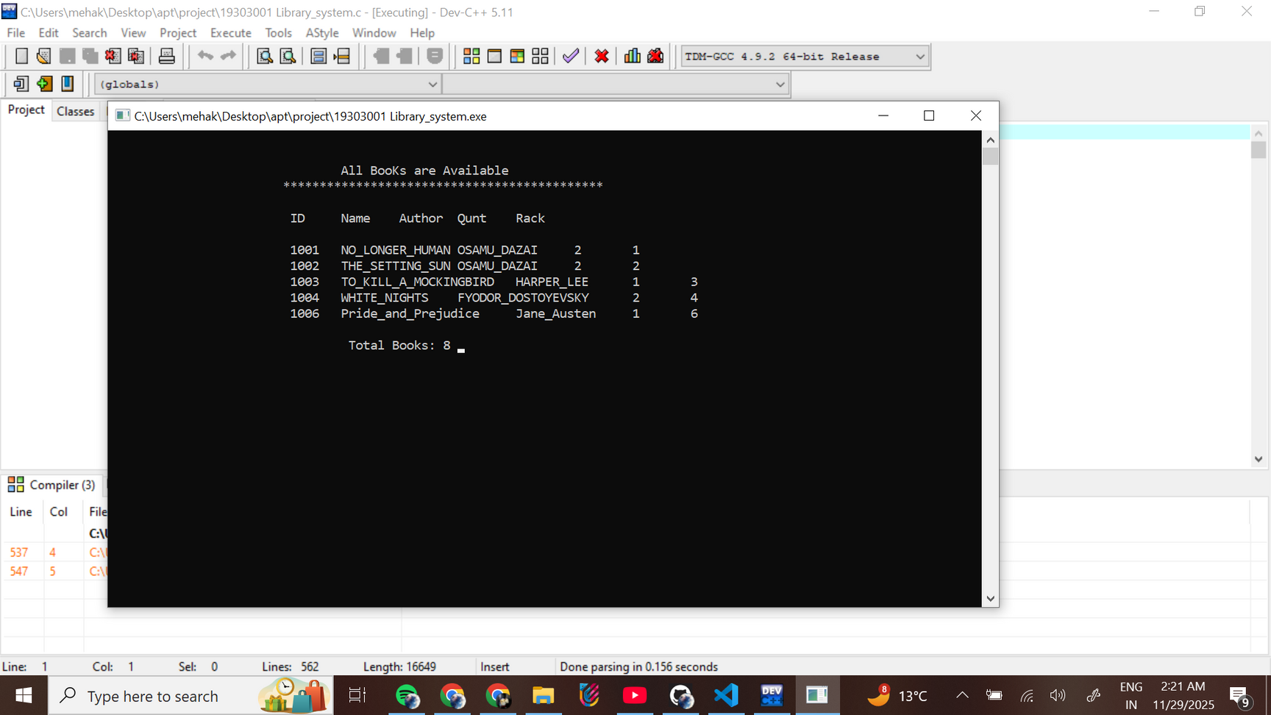

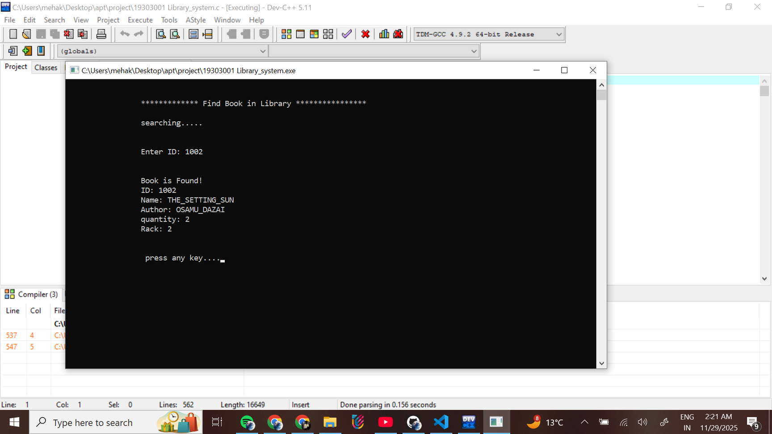
CREATE USER PROFILE
USER
LOGIN
USER MENU
CHOICE 2
CHOICE 1
CHOICE 3

Slide 12
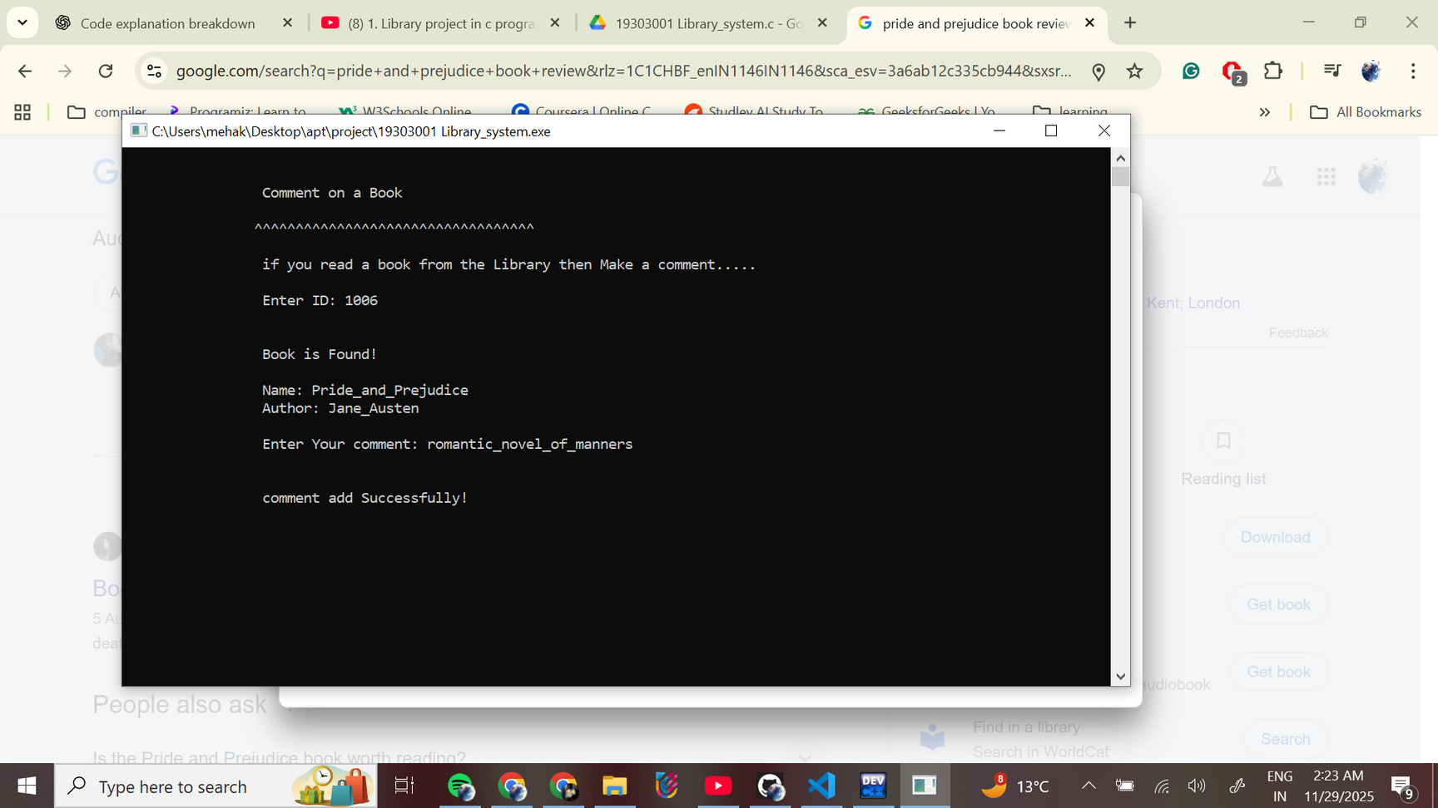
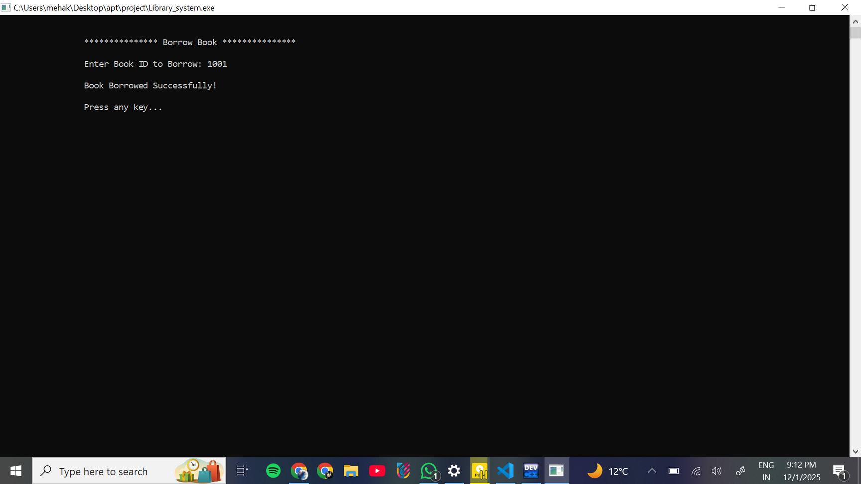
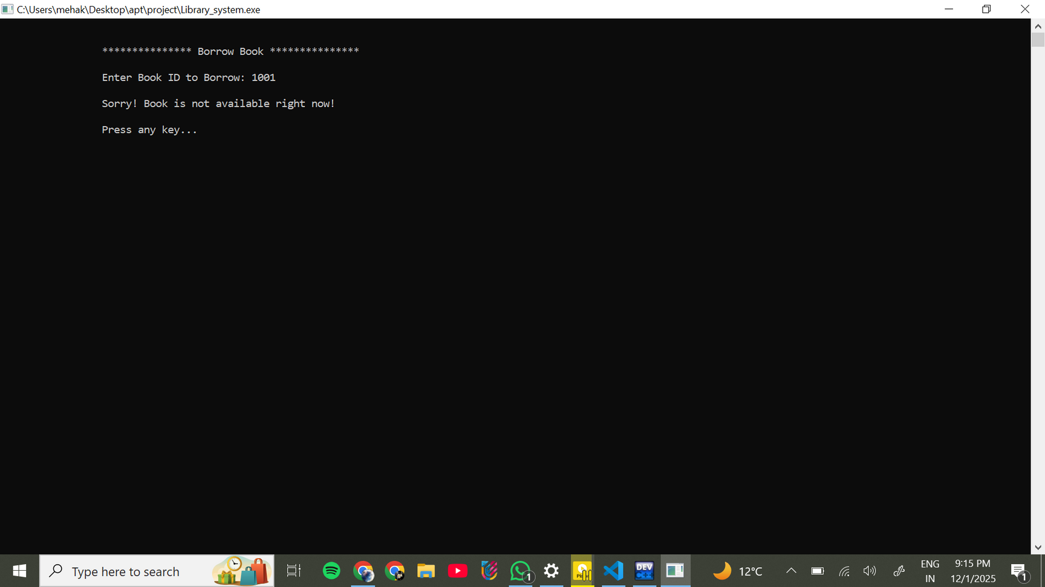

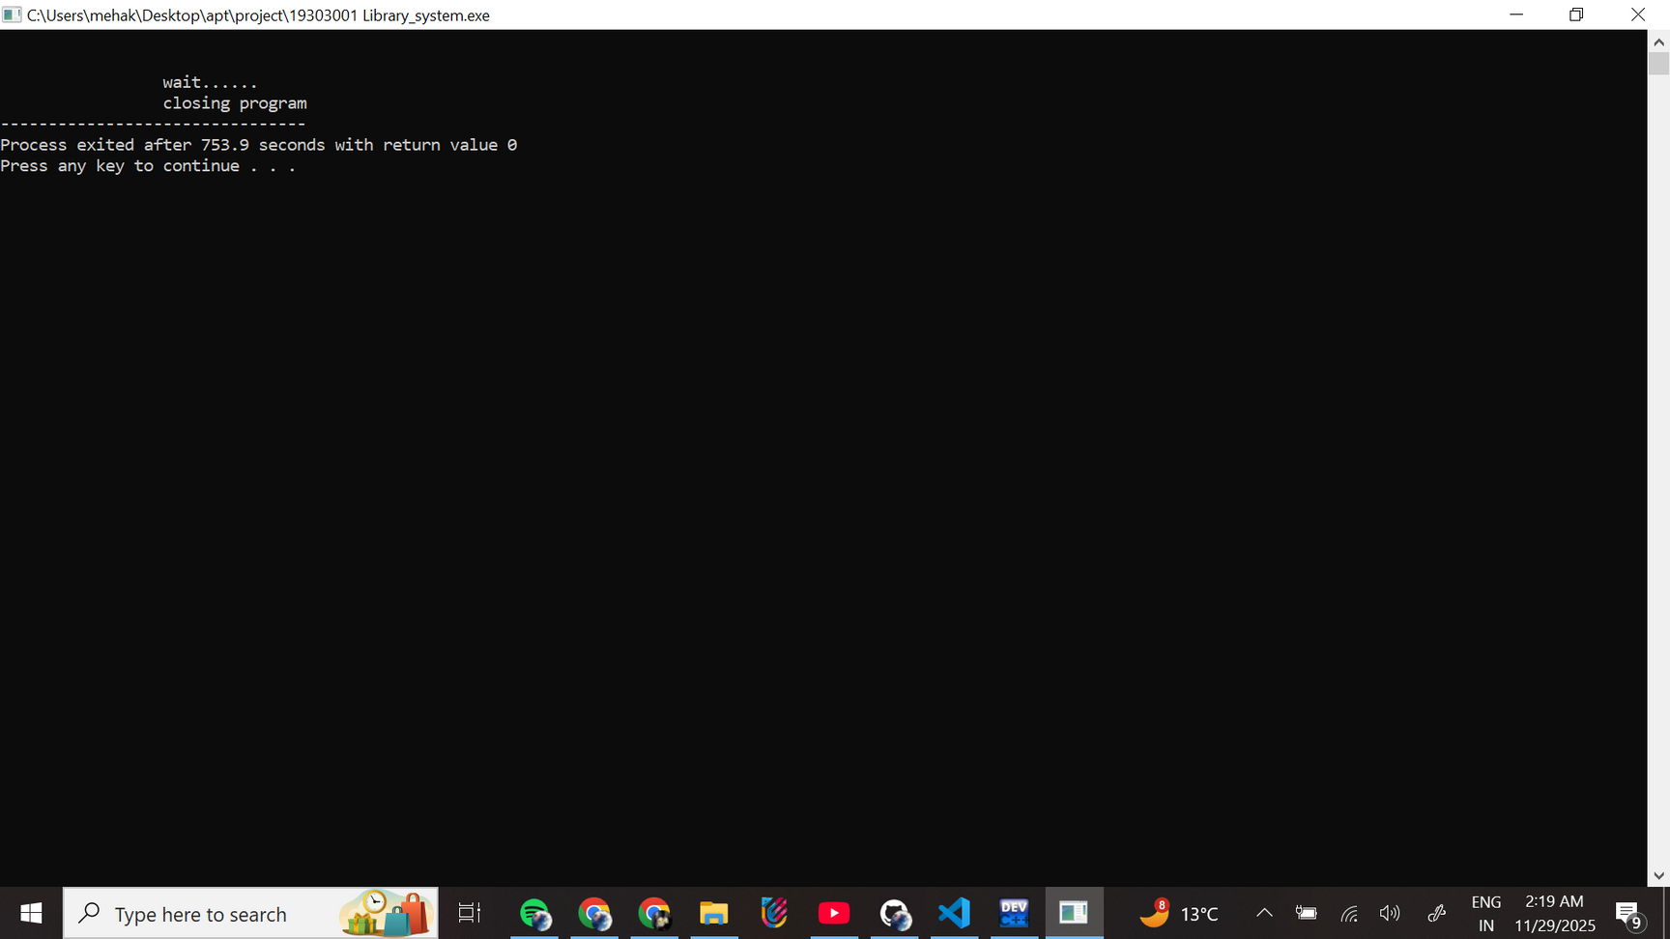
CHOICE 4
CHOICE 6
CHOICE 7
CHOICE 5

Slide 13


C FEATURES USED
Functions
Structures (struct)
File Handling (fopen, fread, fwrite, fseek, remove, rename)
Pointers & File Pointers
String Handling (strcmp, strcpy, scanf)
Loops and Conditional Statements
Menu-driven Program (nested options)
Global Variables
Arrays for storing names, authors, passwords

Slide 14
Unique or Innovative Features
Role-Based System: Separate Admin and User modules make the system more secure and realistic.
Permanent File Storage: All data (books, users, admins, comments) is saved using structured files, making it work like a small database.
Safe Update/Delete Mechanism: Uses temporary file method to prevent data loss during editing or deletion.
Borrow & Return Tracking: Automatically updates book quantity, adding real-time inventory management.
Comment System: Users can give feedback on books, improving interaction and usefulness.
Login Security: Limited login attempts for both admin and users to prevent misuse.
Modular Code Design: Each task is handled by a separate function, increasing readability, maintainability, and reliability.

Slide 15
CONCLUSION
“In this project, we built a simple and user-friendly Library Management System that makes everyday library work faster and more organized. It replaces manual registers with a digital system that can store books, manage users, and handle borrowing, returning, and searching in a more accurate way.
By using C programming and file handling, the system keeps data safe even after closing the program. Admins can easily manage books, and users can quickly find and borrow the books they need. Overall, this project shows how a small software solution can make library operations smoother, reduce errors, and save time for both readers and librarians.
This system may be basic, but it successfully proves how technology can simplify real-life tasks.”

Slide 16
THANK YOU

